Slide 1





🏙️ VSCODERS AND THE JETBRAINSTORMERS👨‍💻
CITY
BUILDER SIMULATOR
You can find our report here :)

Slide 2





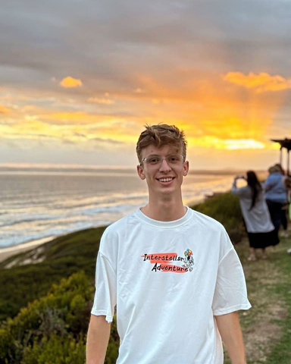


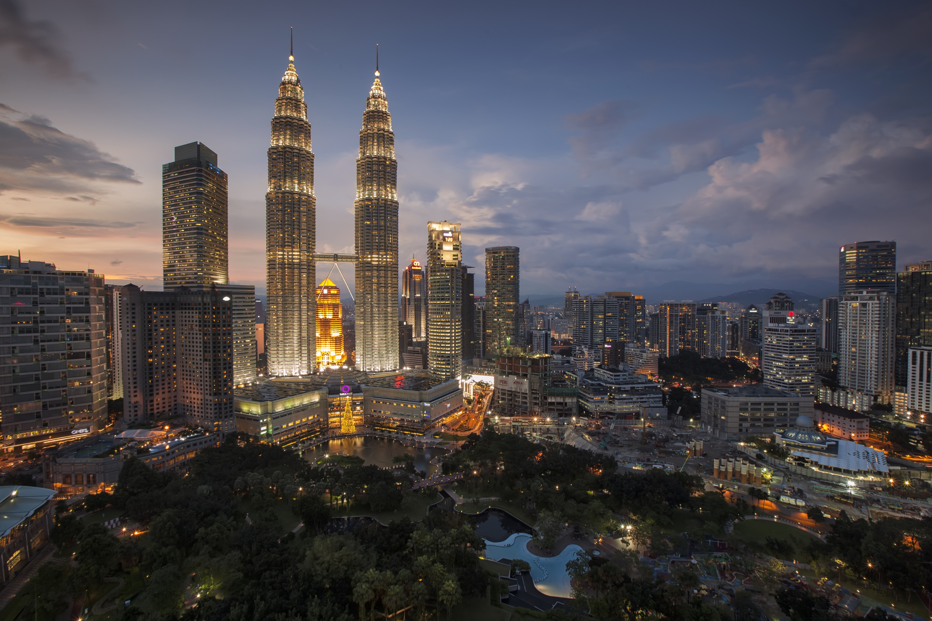

MEET THE TEAM
Mr. Shayden Naidoo
Miss. Zainab Abdulrasaq
Mr. Navendran Naidoo
u23599236
u22566202
u21512494
Team lead and Taxes: Financial and Taxation Strategist
Buildings: Infrastructure and Building Manager
Resources: Resource Management Specialist
Mr. Arnaud Strydom
Mr. Neo Machaba
Mr. Samvit Prakash
u23536013
u23002167
u23525119
Citizens and game dev: Citizen Welfare and Demographics Analyst and front end Game developer
Utilities: Utilities and Service Manager
Transportation: Transportation Systems Coordinator
Mr. Rudolph Lamprecht
u20598425
Government: City Governance Manager

Slide 3

ON THE AGENDA:
01
02
03
04
05
Functional Requirements
UML Class Diagram
Explanation of the Patterns Used
UML State Diagram
UML Activity Diagram
06
07
08
09
UML Sequence Diagram
UML Communication Diagram
UML Object DIagram
System Architecture

Slide 4

FUNCTIONAL REQUIREMENTS
Building Management
Utility Management
Transportation Systems
Citizen Simulation
Government System
Resource Management
City Growth
Taxation and Finance

Slide 5
PATTERNS
USED
Factory
Observer
Mediator
Strategy
State
Chain of responsibility
Iterator
Builder
Template
Command
Prototype
Adapter

Slide 6

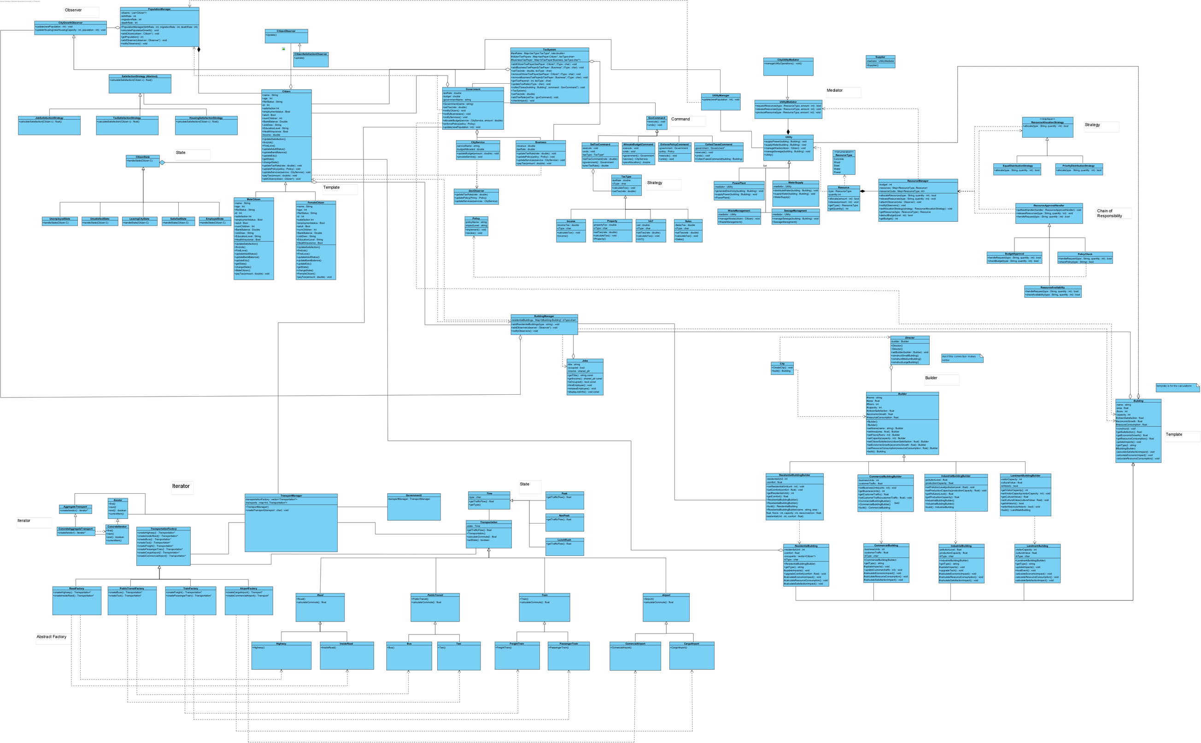
Class Diagram

Slide 7
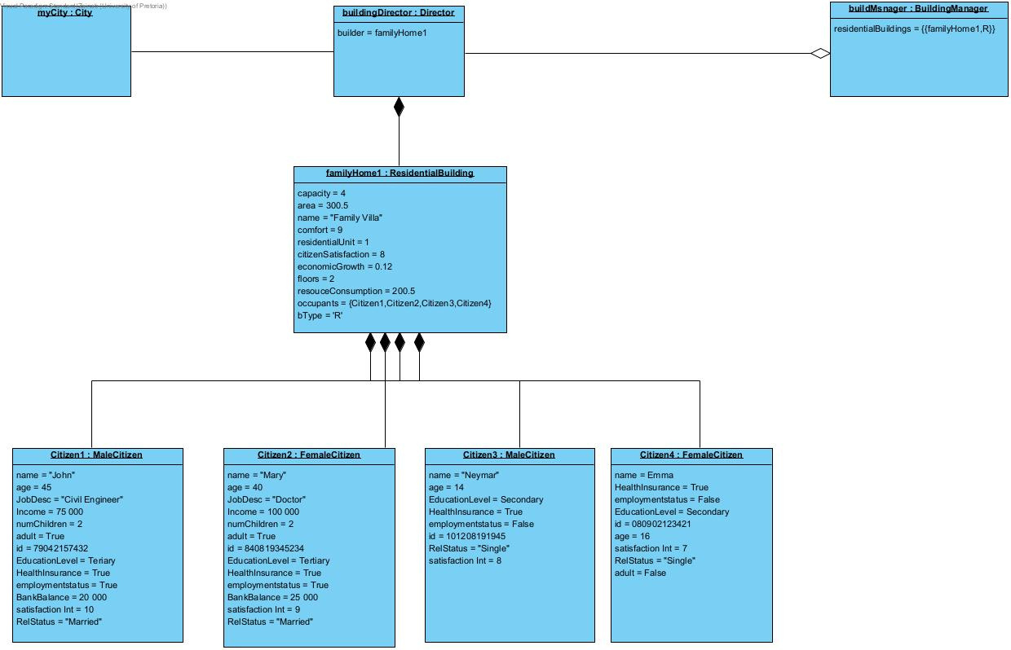
Citizen Creation
Object Diagram

Slide 8
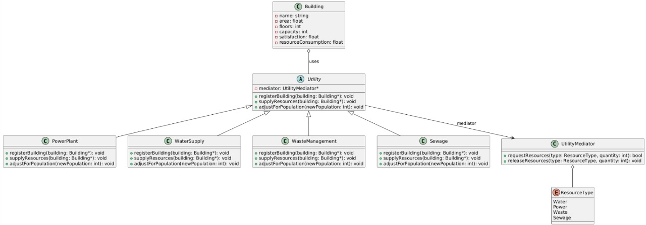
Utilities
Object Diagram

Slide 9
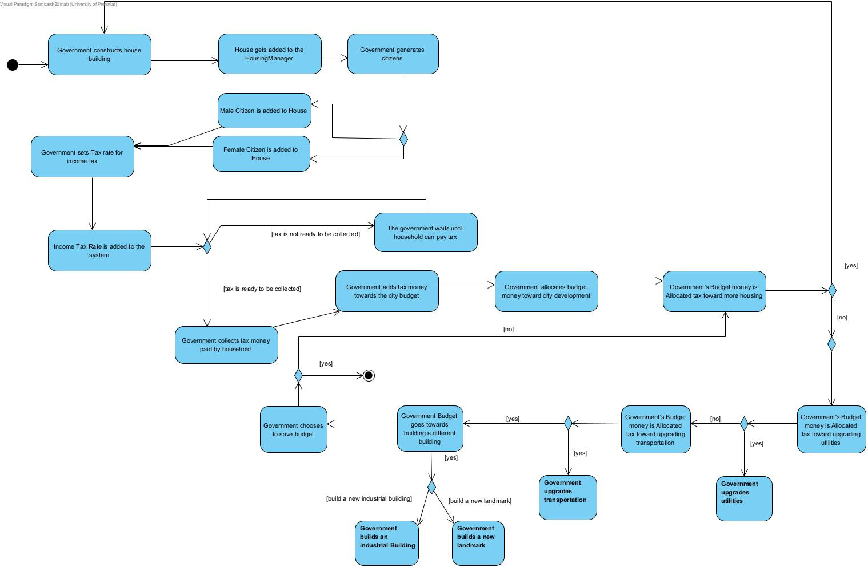
Government
Activity Diagram

Slide 10
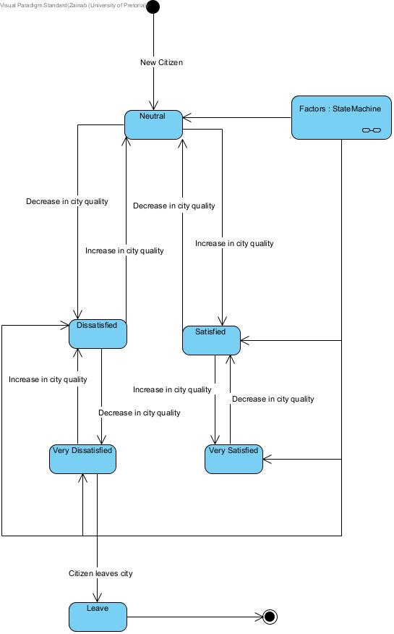
Citizen Satisfaction
State Diagram

Slide 11
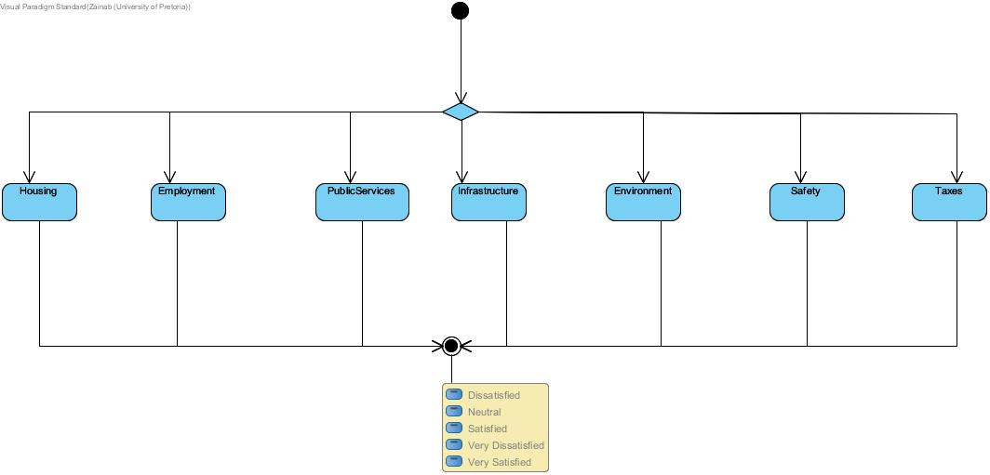
Citizen Satisfaction
State Diagram cont.

Slide 12
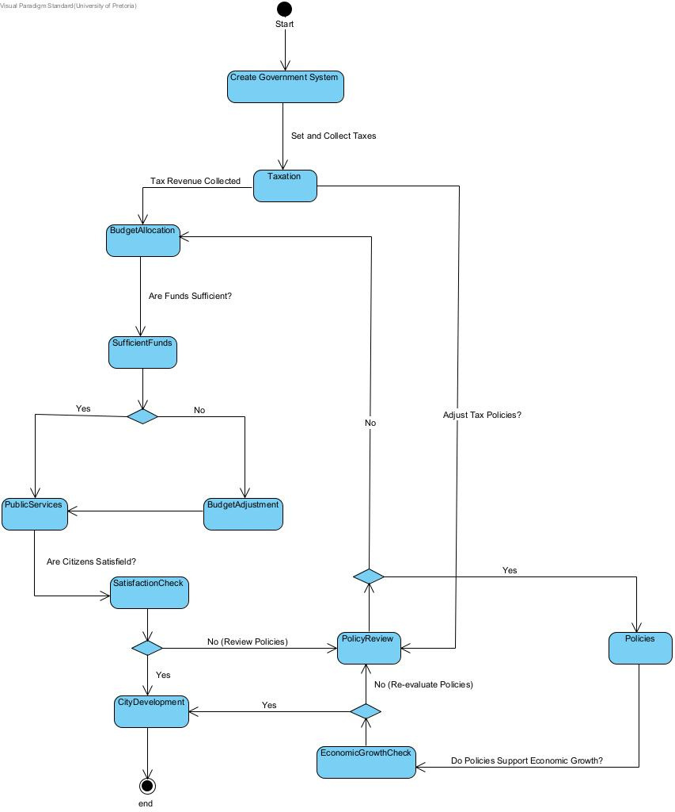
Government
State Diagram

Slide 13
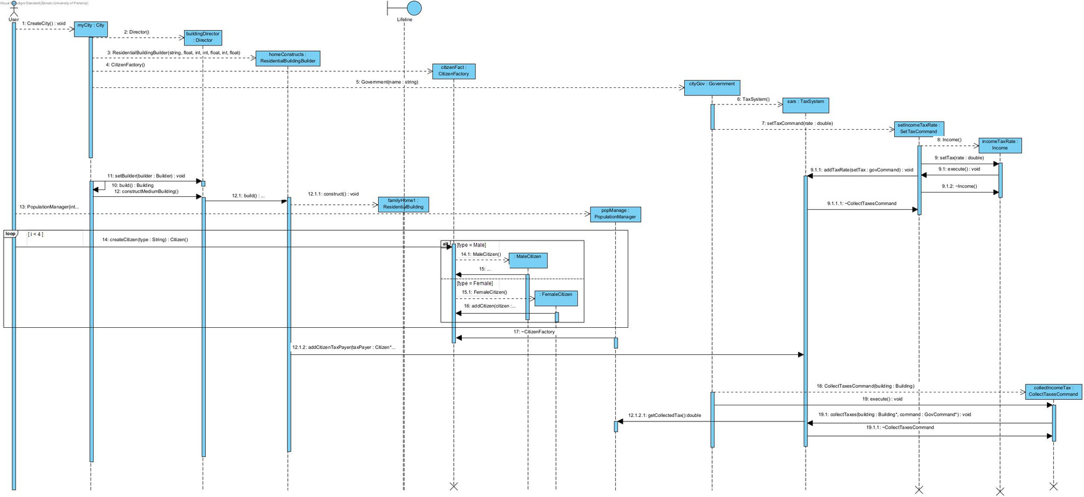
City Creation
and Tax Impact
State Diagram

Slide 14
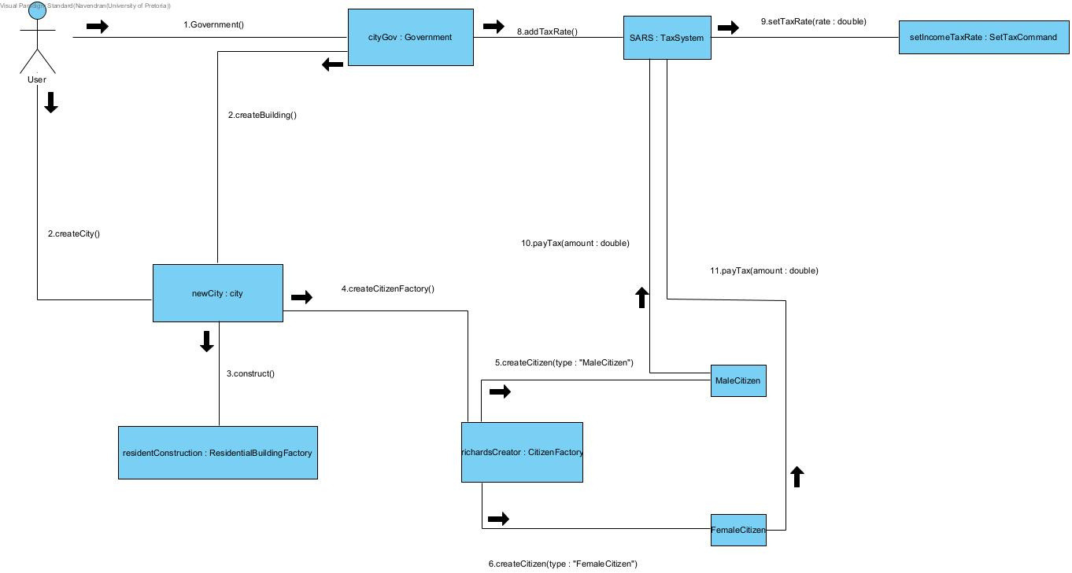
Communication
Diagram

Slide 15
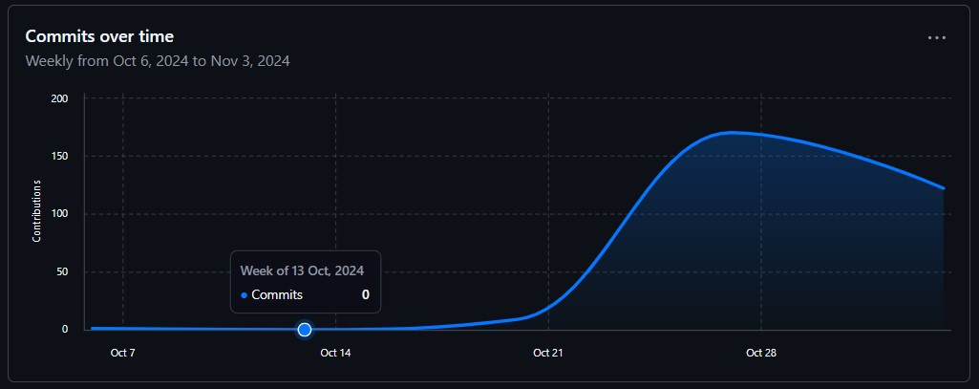
OUR GIT-COMMIT GRAPHS

Slide 16
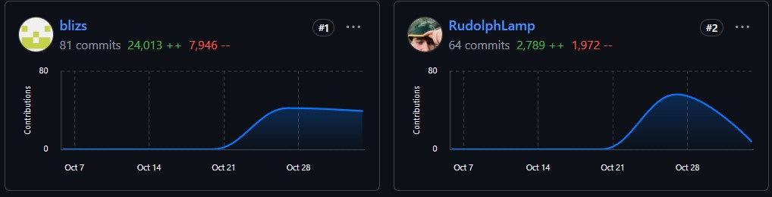
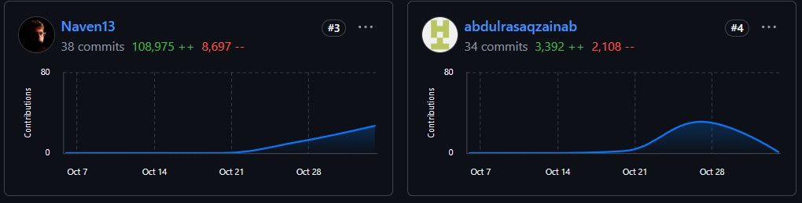
OUR GIT-COMMIT GRAPHS

Slide 17
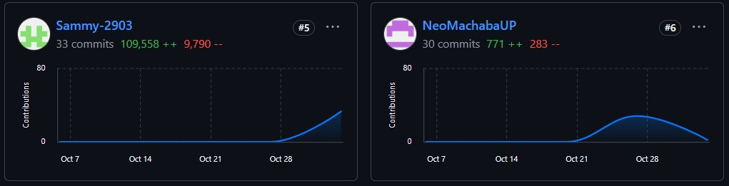
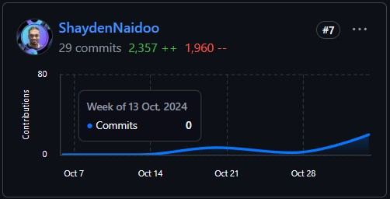
OUR GIT-COMMIT GRAPHS

Slide 18
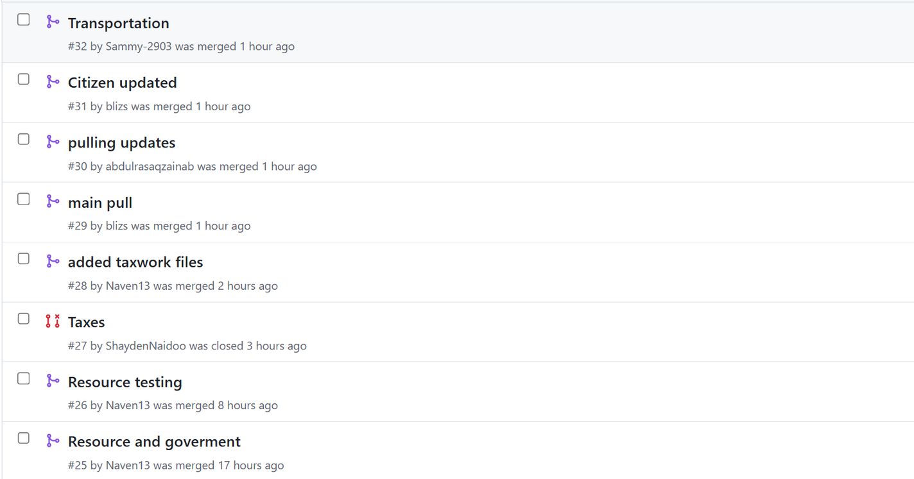
OUR GIT-PULL REQUESTS

Slide 19
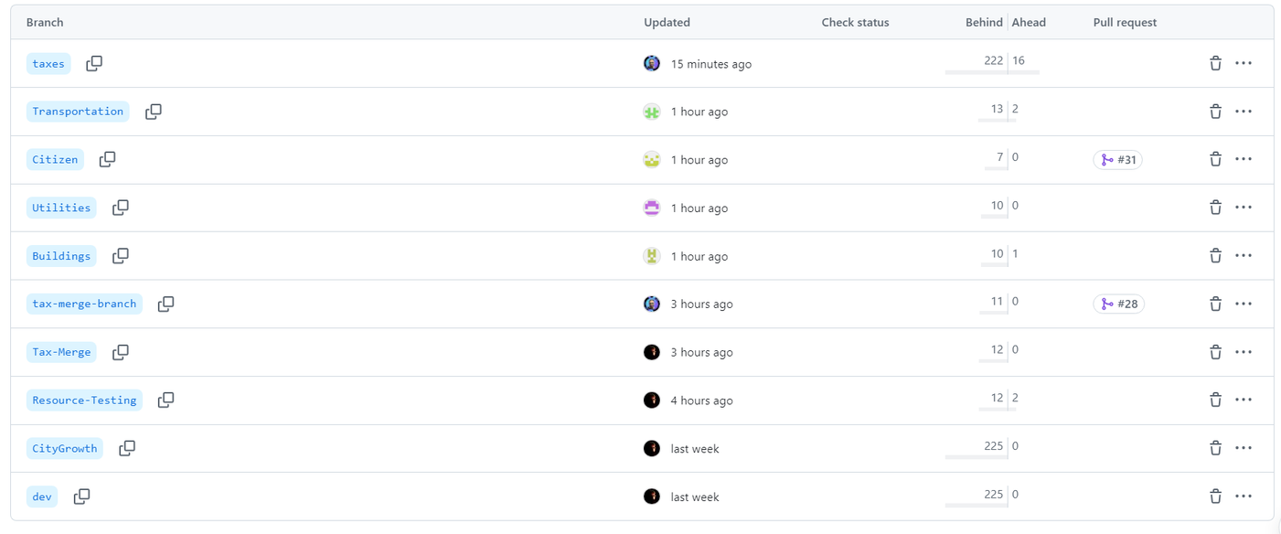
OUR GIT-BRANCHES

